Slide 1

Week #2
AI Academy®
1
Day 1:
Introduction of OOP
Terminologies of OOP
Classes, Objects, Inheritance, Polymorphism, Data Abstraction, Encapsulation, Destructor
Session, Cookies
Reviews & Feedbacks

Slide 2
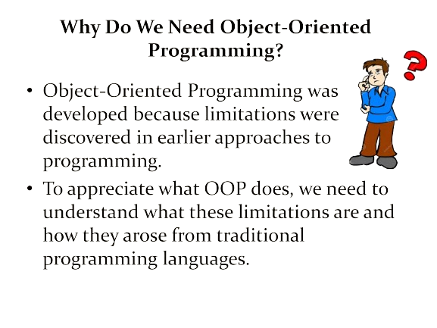
Week #2
AI Academy®
1

Slide 3
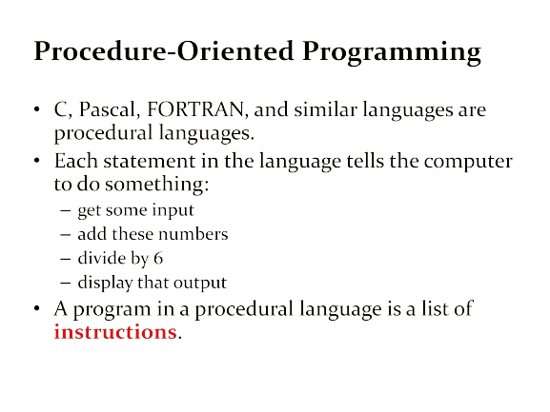
Week #2
AI Academy®
1

Slide 4
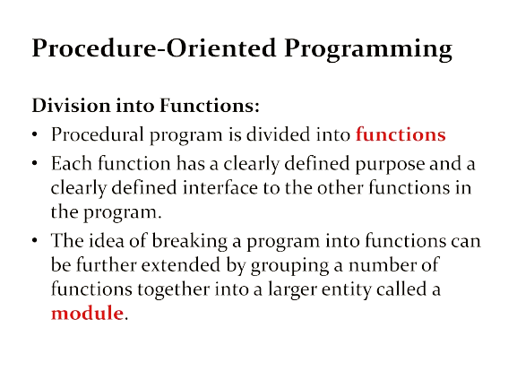
Week #2
AI Academy®
1

Slide 5
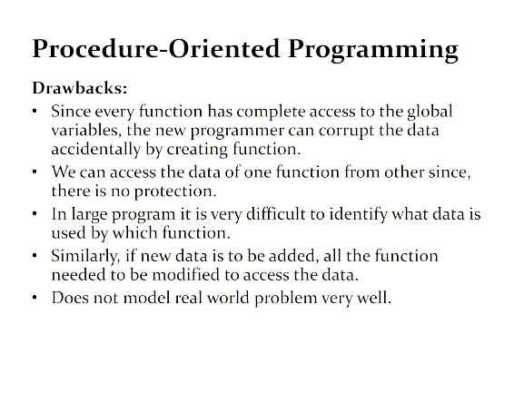
Week #2
AI Academy®
1

Slide 6
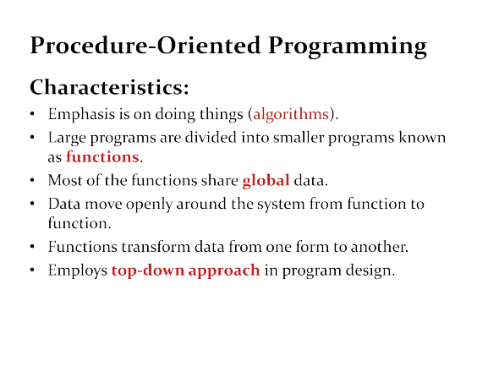
Week #2
AI Academy®
1

Slide 7
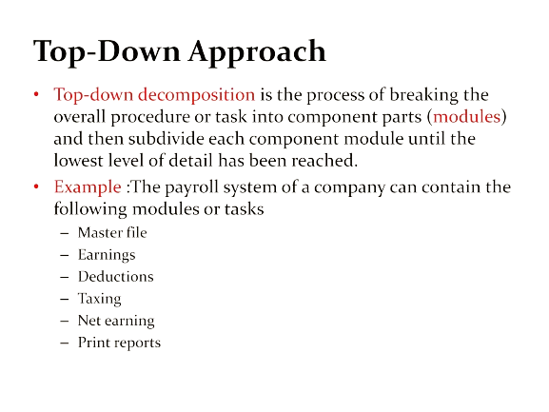
Week #2
AI Academy®
1

Slide 8
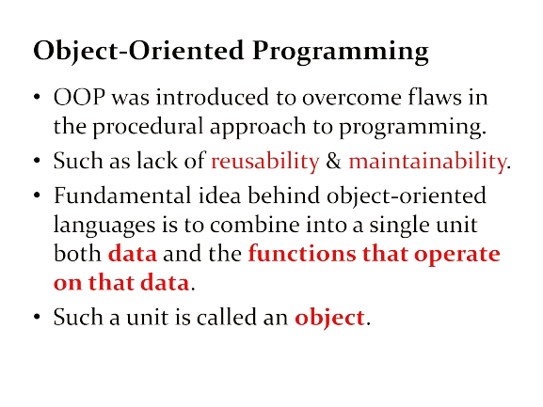
Week #2
AI Academy®
1

Slide 9
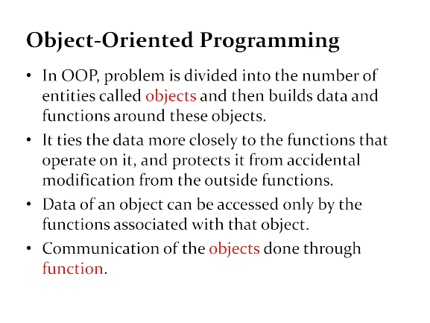
Week #2
AI Academy®
1

Slide 10
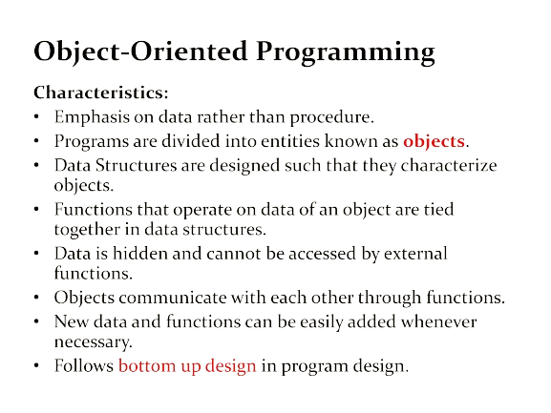
Week #2
AI Academy®
1

Slide 11
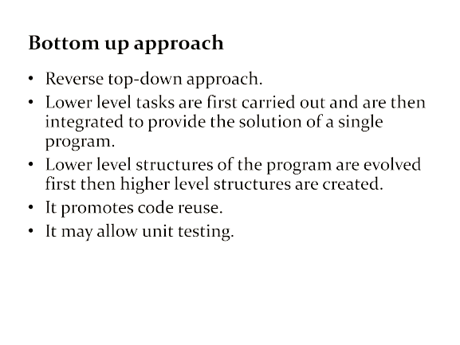
Week #2
AI Academy®
1

Slide 12
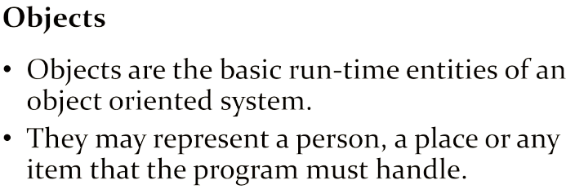

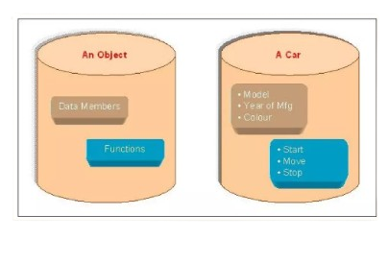
Week #2
AI Academy®
1

Slide 13
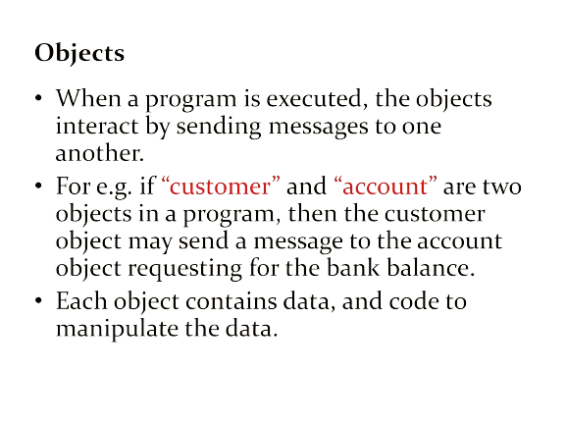
Week #2
AI Academy®
1

Slide 14
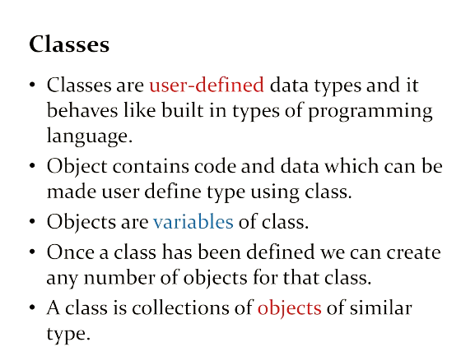
Week #2
AI Academy®
1

Slide 15
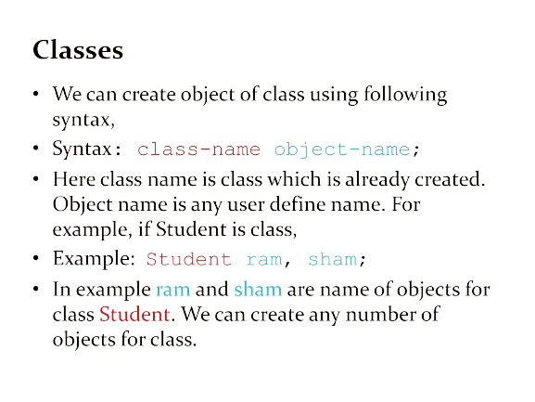
Week #2
AI Academy®
1

Slide 16
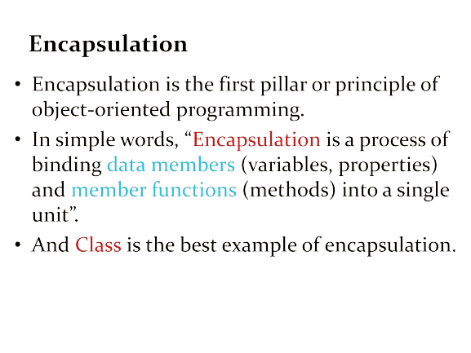
Week #2
AI Academy®
1

Slide 17
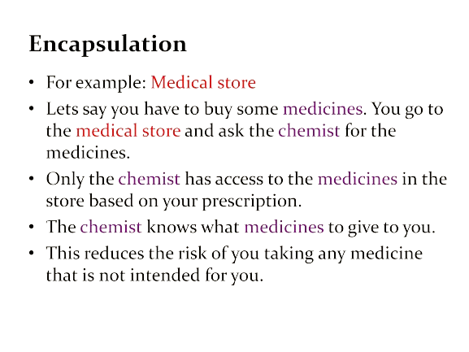
Week #2
AI Academy®
1

Slide 18
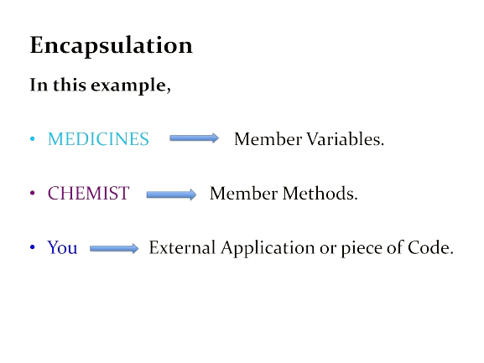
Week #2
AI Academy®
1

Slide 19
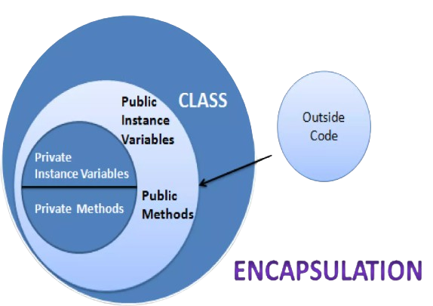
Week #2
AI Academy®
1

Slide 20
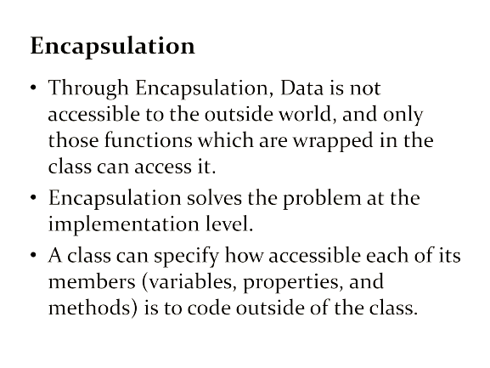
Week #2
AI Academy®
1

Slide 21
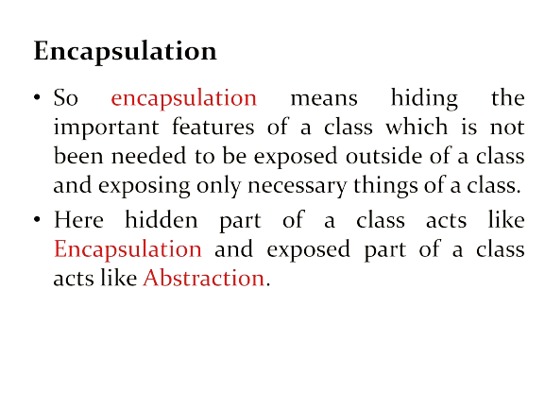
Week #2
AI Academy®
1

Slide 22
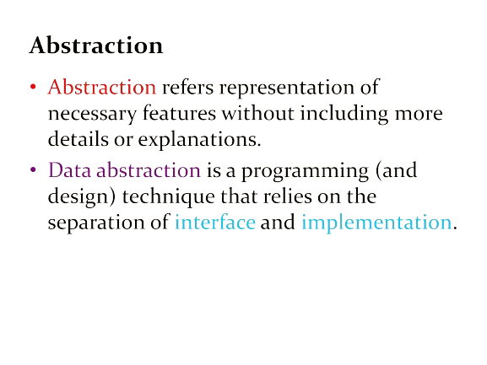
Week #2
AI Academy®
1

Slide 23
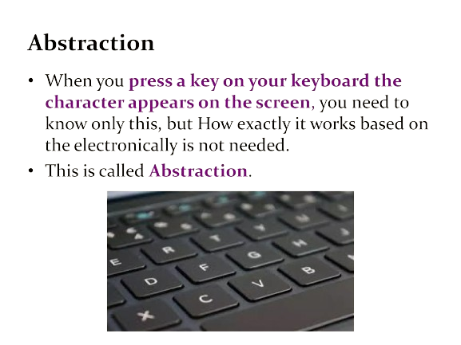
Week #2
AI Academy®
1

Slide 24
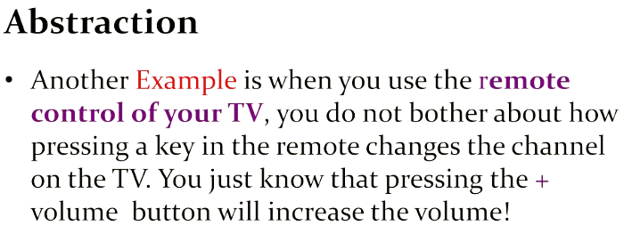

Week #2
AI Academy®
1

Slide 25
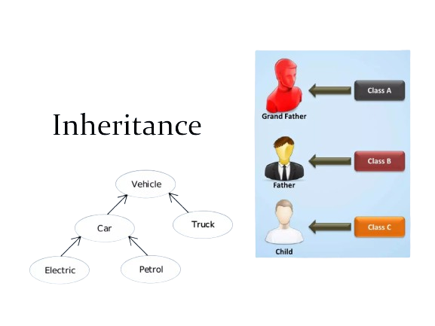
Week #2
AI Academy®
1

Slide 26
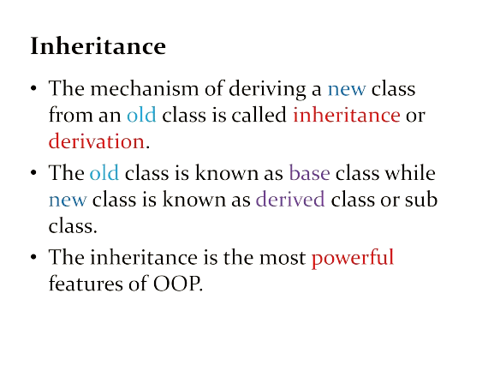
Week #2
AI Academy®
1

Slide 27
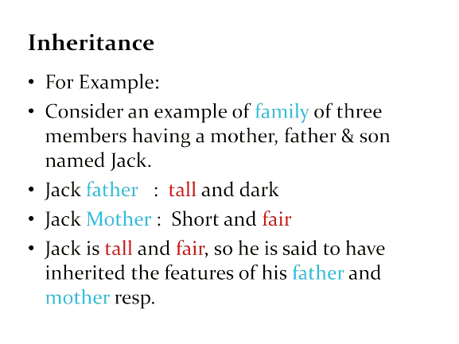
Week #2
AI Academy®
1

Slide 28
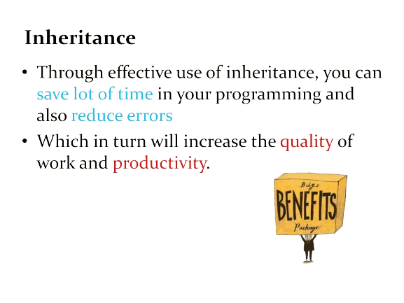
Week #2
AI Academy®
1

Slide 29
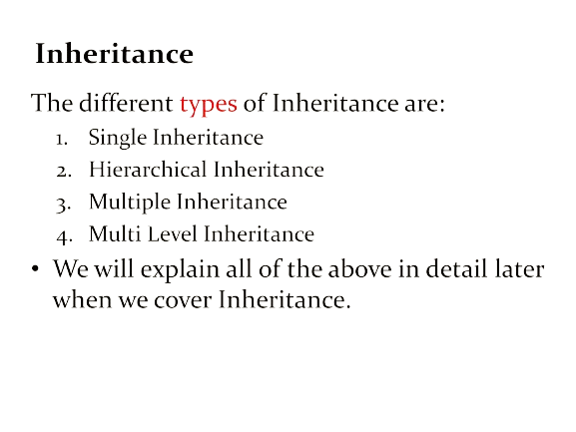
Week #2
AI Academy®
1

Slide 30
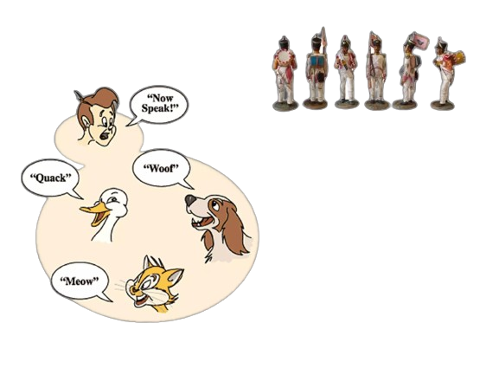

Week #2
AI Academy®
1

Slide 31
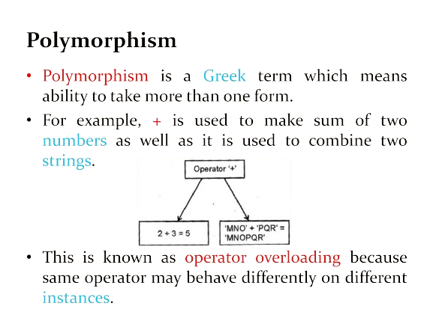
Week #2
AI Academy®
1

Slide 32
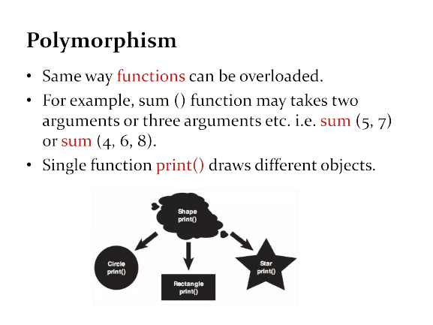
Week #2
AI Academy®
1

Slide 33



Week #2
AI Academy®
1

Slide 34
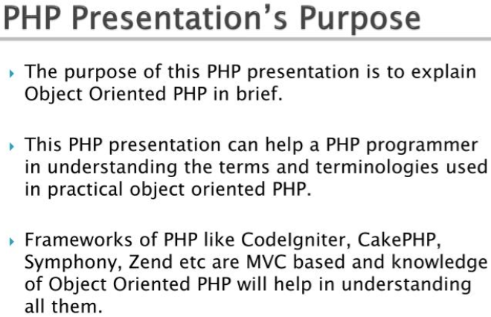
Week #2
AI Academy®
1

Slide 35
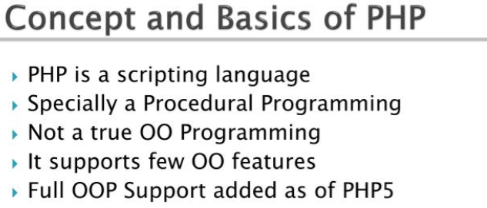
Week #2
AI Academy®
1

Slide 36
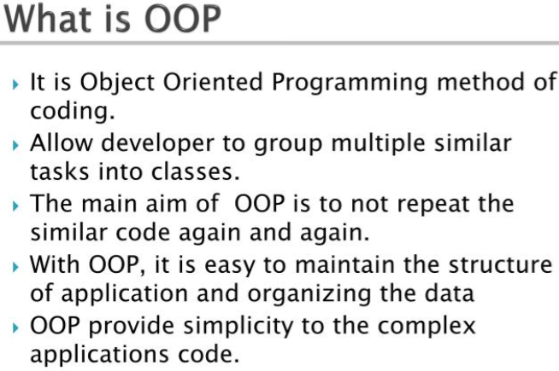
Week #2
AI Academy®
1

Slide 37
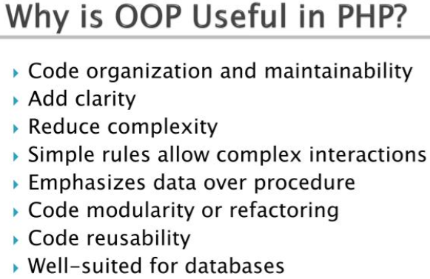
Week #2
AI Academy®
1

Slide 38
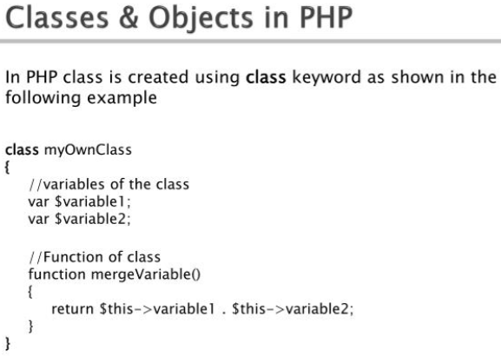
Week #2
AI Academy®
1

Slide 39
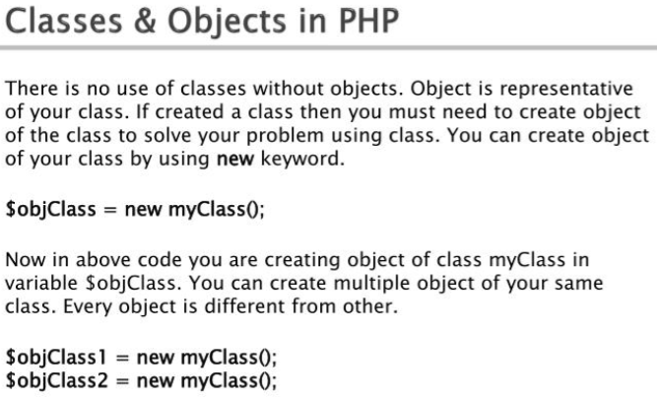
Week #2
AI Academy®
1

Slide 40
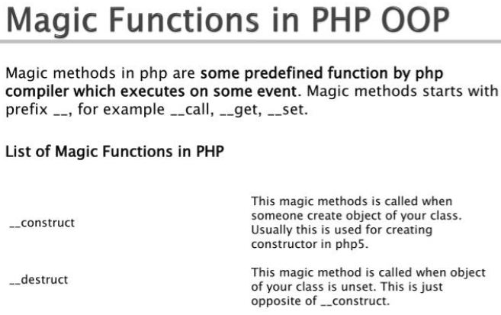
Week #2
AI Academy®
1

Slide 41
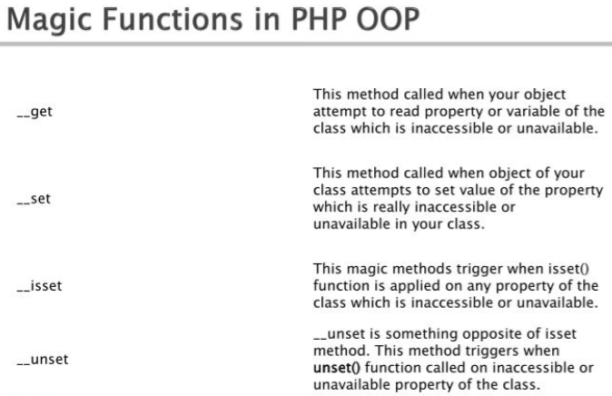
Week #2
AI Academy®
1

Slide 42
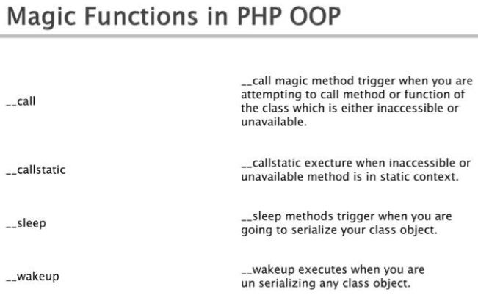
Week #2
AI Academy®
1

Slide 43
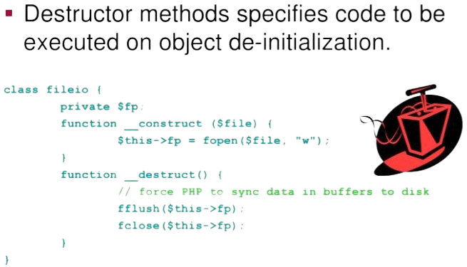
Week #2
AI Academy®
1

Slide 44
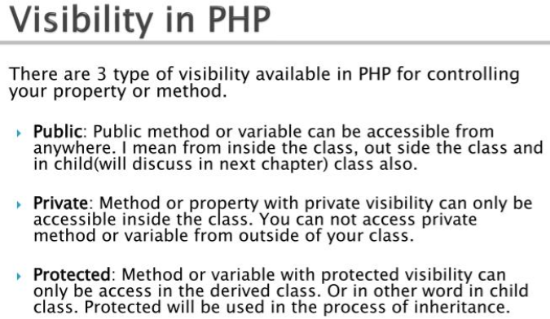
Week #2
AI Academy®
1

Slide 45
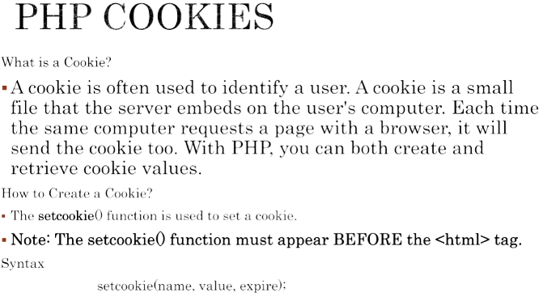
Week #2
AI Academy®
1

Slide 46
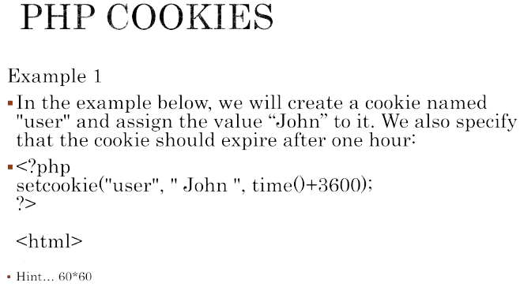
Week #2
AI Academy®
1

Slide 47
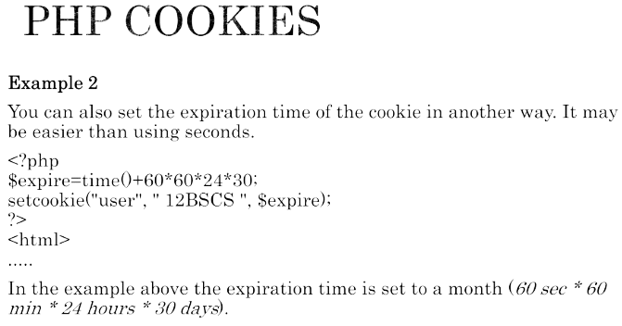
Week #2
AI Academy®
1

Slide 48
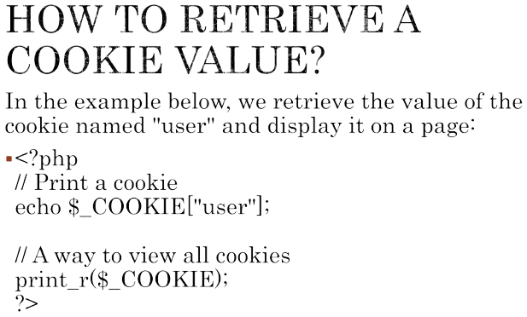
Week #2
AI Academy®
1

Slide 49
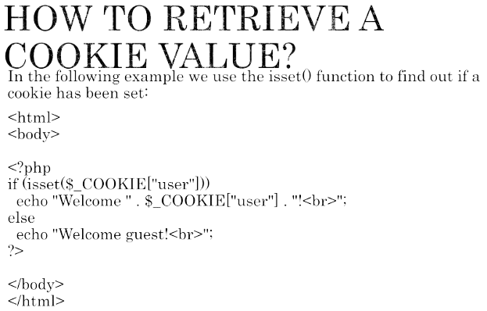
Week #2
AI Academy®
1

Slide 50
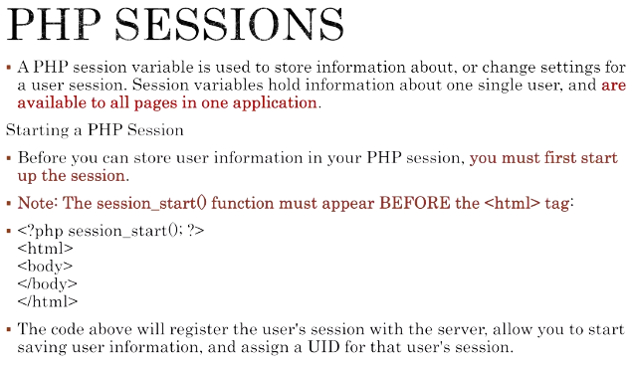
Week #2
AI Academy®
1

Slide 51
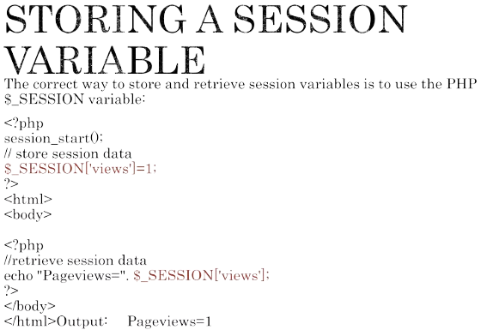
Week #2
AI Academy®
1

Slide 52

Week #2
AI Academy®
1

Slide 53

Week #2
AI Academy®
1

Slide 54
Week #2
AI Academy®
5
Day 2:
MySQL Basics, Create DB, PHP My Admin
DDL, DML, DRL Operations in SQL
DB Integration with PHP
Crude Operation in MySQL
Reviews & Feedbacks

Slide 55

Week #2
AI Academy®
1

Slide 56


Week #2
AI Academy®
1

Slide 57


Week #2
AI Academy®
1

Slide 58


Week #2
AI Academy®
8

Slide 59

Week #2
AI Academy®
16

Slide 60


Week #2
AI Academy®
20

Slide 61


Week #2
AI Academy®
20

Slide 62



Week #2
AI Academy®
20

Slide 63

Week #2
AI Academy®
20

Slide 64


Week #2
AI Academy®
20

Slide 65


Week #2
AI Academy®
20

Slide 66

Week #2
AI Academy®
20

Slide 67

Week #2
AI Academy®
20

Slide 68

Week #2
AI Academy®
20
See the Exercise On
PHP Database Integration
GitHub @theaamirlatif

